Slide 1


SUPERVISED BY
Mrs.DEEPA.J
PRESENTED BY
1. C. Gayani (VTU 27065)(23UEIT0069)
2. Y. Manisha (VTU 26079)(23UEIT0068)

Slide 2
"Cloud-Enabled AI and IoT Integration for Smart Land Use and Public Health"
AGENDA
Introduction
Literature Survey
Problem Statement
Proposed Methodology
Proposed System Architecture
Implementation Details
Testing & Validation
Preliminary Results & Analysis
Conclusion and Future Work
References

Slide 3
Introduction
Problem Statement
Urbanization, industrial expansion, and agricultural pressures are rapidly changing patterns of land use across many regions.
These changes often lead to deforestation, soil degradation, air and water pollution, and loss of biodiversity, all of which directly impact public health and environmental sustainability.
Traditional methods for land-use monitoring and health risk assessment rely heavily on manual data collection, delayed reporting, and isolated data sources, which make it difficult to respond effectively to emerging issues such as disease outbreaks or pollution events.
There is a growing need for an intelligent, technology-driven solution that can integrate diverse environmental and health data sources, analyze them in real time, and generate actionable insights for policymakers, researchers, and communities.

Slide 4
Project Goal
The primary goal of this project is to design and implement a cloud-enabled AI and IoT-based system that facilitates real-time data collection, analysis, and visualization for smart land use and public health management.
Collect continuous environmental data from distributed IoT sensors (e.g., air quality, soil moisture, temperature, humidity, water quality).
Process and store this data efficiently on a scalable cloud platform.
Apply artificial intelligence and machine learning models to identify patterns, predict land-use changes, and assess potential health risks.
Provide stakeholders with an interactive dashboard and mobile interface to support data-driven policy decisions and public awareness initiatives.

Slide 5
Brief Review
This project integrates Internet of Things (IoT) technology, cloud computing, and artificial intelligence (AI) into a unified framework.
IoT sensors deployed across targeted zones continuously capture multi-dimensional data related to air, water, and soil quality. The data is transmitted securely to a cloud environment where it is preprocessed, stored, and analyzed using AI algorithms. These algorithms help detect trends, correlations, and anomalies — for example, linking high air pollution levels to respiratory illness spikes or identifying land degradation hotspots.
The processed insights are then made accessible through an intuitive dashboard and mobile app, offering real-time visualizations, alerts, and recommendations for both authorities and citizens. By combining technology and analytics, the system enhances the ability to plan land use intelligently, mitigate health risks, and promote a more sustainable and healthier environment.

Slide 6
Literature Survey
Existing Systems and Related Works:
Smart Land Use & Urban Planning: AI analyzes spatial data for efficient land utilization.
Public Health Monitoring: IoT sensors and wearables track health in real time.
Environmental & Sustainability Applications: AI + IoT monitor pollution, climate, and biodiversity
Smart Healthcare & Urban Well-being: AI-driven disease prediction, personalized treatment.

Slide 7
Problem Statement
1. Data Privacy and Security
Challenge: Health and urban data are highly sensitive. IoT devices and cloud platforms often transmit personal or geolocation data over networks, creating vulnerability.
Current gap: Many solutions lack end-to-end encryption, secure authentication, or privacy-preserving AI models.
Impact: Unauthorized access can lead to misuse of personal health data, regulatory non-compliance (e.g., HIPAA, GDPR), and public distrust.
Limitations of Existing Solutions

Slide 8
2. Interoperability Issues
Challenge: IoT devices are manufactured by different vendors with varying protocols and communication standards.
Current gap: Integrating heterogeneous sensors and data streams into a unified AI-driven platform is complex.
Impact: Fragmented systems limit the ability to perform holistic urban planning or public health monitoring.
3. Scalability Challenges
Challenge: Real-time monitoring of large urban areas and populations generates massive datasets.
Current gap: Many cloud platforms are not optimized for high-throughput, low-latency processing.
Impact: Systems may face delays in decision-making, reducing their effectiveness in time-sensitive situations such as disaster response or disease outbreaks.

Slide 9
4. Data Quality and Reliability
Challenge: IoT sensors may produce noisy, incomplete, or inconsistent readings due to environmental interference, hardware failures, or calibration errors.
Current gap: Limited error-checking, redundancy, or self-healing mechanisms in data pipelines.
Impact: AI models trained on low-quality data may provide inaccurate predictions for land use optimization or public health management.

Slide 10
Proposed Methodology
System Design & Requirements (Planning)
Stakeholder analysis identify farmers, city planners, public-health agencies, researchers.
Functional requirements real-time sensing, predictive alerts, dashboards, APIs for 3rd-party systems.
Non-functional requirements latency (<2s for critical alerts), availability (>98%), security (TLS, RBAC), scalability.

Slide 11
Sensing & Edge Layer (Data Acquisition)
Sensor selection & placement
Soil: moisture, pH, EC sensors.
Air: PM2.5/PM10 (MQ/optical), NO₂, O₃, CO.
Water: turbidity, contamination sensors.
Weather: temperature, humidity, wind, rainfall.
Imaging: low-altitude drones / fixed cameras (RGB, multispectral).
Edge nodes — microcontrollers (ESP32, Raspberry Pi) with local buffering and preprocessing.
Connectivity — LoRaWAN for wide-area, Wi-Fi / Cellular for high-bandwidth nodes (drones/cameras).
Local actuation — relays, irrigation controllers, sirens for immediate interventions.

Slide 12
Edge Processing & Gateway (Preprocessing & Filtering)
Data cleaning & validation
Range checks, sensor sanity checks, de-noising (moving average).
Lightweight edge analytics
Threshold checks, simple anomaly detection, event batching.
Compression & secure transport
MQTT/HTTP over TLS; payload compression for low-bandwidth links.
Gateway functions
Protocol translation, local time-series cache, OTA firmware updates.

Slide 13
AI Analytics & Modeling (Core Intelligence)
Join sensor streams, satellite/drone imagery, historical health records, land-use maps.
Feature engineering: time-lags, rolling statistics, meteorological indices, vegetation indices (NDVI).
Anomaly detection: Isolation Forest / Autoencoders for sensor anomalies and pollution spikes.
Time-series forecasting: LSTM / Prophet / Temporal Fusion Transformer for pollution, soil moisture, disease risk.
Spatial models: Random Forest / XGBoost + GIS feature layers for land degradation and hotspot mapping.
Image models: CNN / U-Net for crop stress, land-cover classification from drone/satellite imagery.
Risk scoring: Ensemble models that combine environmental forecasts + social/data indicators to output public-health risk indices.
Offline training pipeline (batch), periodic retraining with drift detection, and online inference API for near-real-time predictions.

Slide 14
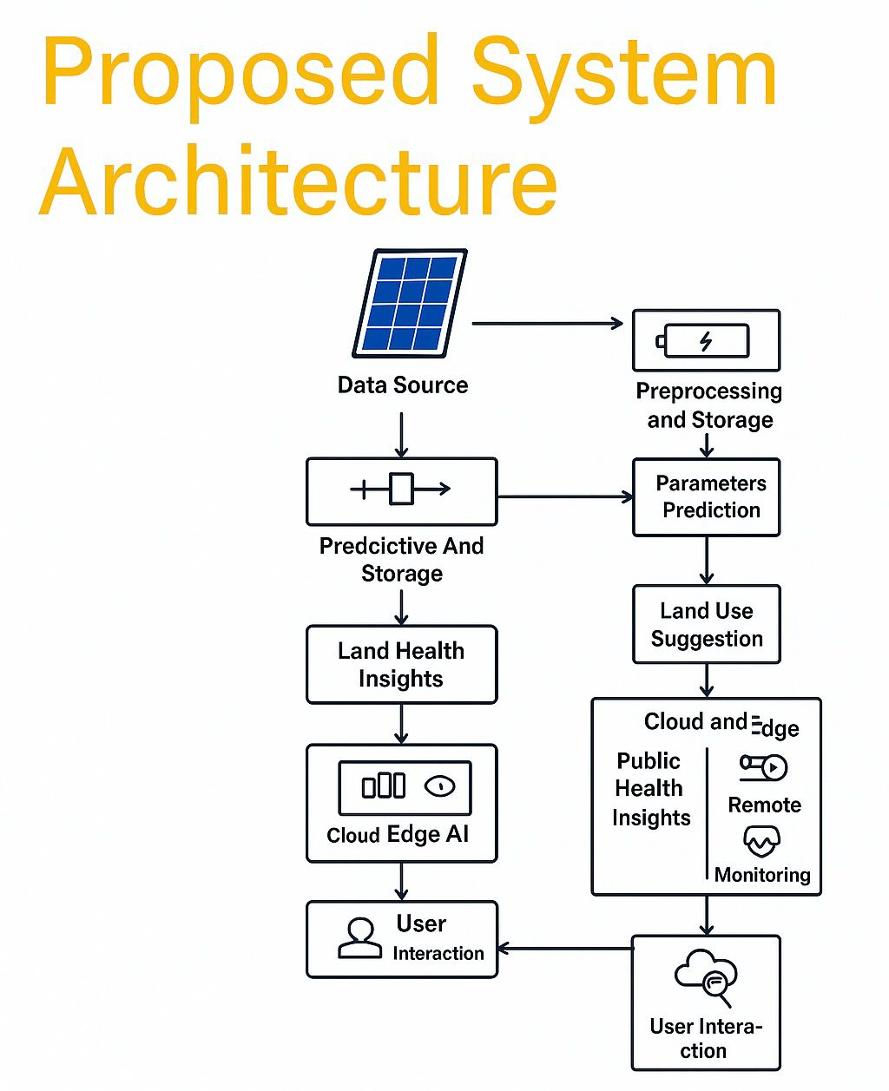

Slide 15
Summary of Module -1
The integration ensures scalability, automation, and remote accessibility of systems, improving resource management and health resilience.
Components Used:
1. IoT Layer: Sensors and devices gather real-time data.
2. Cloud Layer: Stores, processes, and manages large-scale data securely.
3. AI Layer: Analyzes data for predictive analytics and intelligent decision-making.
4. Application Layer: Provides dashboards and visualizations for stakeholders.
Outcomes:
• Enhanced environmental and public health monitoring
• Smarter land resource allocation
• Improved policy-making through data insights
• Promotion of sustainability and community wellbeing

Slide 16
Summary of Module -2
This module emphasizes the analysis, processing, and intelligent utilization of data collected through IoT devices and cloud platforms.
Components Used:
1. Data Collection & Preprocessing: Cleaning, filtering, and integrating IoT data.
2. Big Data Analytics: Using cloud-based tools to handle large and complex datasets
3. AI & Machine Learning Models: Applying algorithms for prediction.
4. Visualization & Reporting: Creating dashboards for health and land use insights.
5. Decision Support Systems: Assisting planners and policymakers through AI-driven insights.
Outcomes:
• Ability to predict and prevent environmental and health risks.
• Development of AI-based decision models for smart governance.
• Improved data visualization and reporting tools for stakeholders.
• Strengthened integration of AI, IoT, and Cloud Computing.

Slide 17
Summary of Modules -3
This module focuses on the practical design, deployment, and security aspects of implementing integrated AI, IoT, and Cloud-based systems for smart land use and public health.
1. System Architecture Design: Integrating IoT, Cloud, and AI layers into a cohesive framework.
2. Implementation Strategies: Deploying and testing smart systems for land and health monitoring.
3. Communication Protocols: Managing data flow between devices, cloud, and users.
4. Security and Privacy: Applying encryption, authentication, and access control.
5. Edge and Fog Computing: Enhancing system performance and scalability.
Outcomes:
• Understanding of end-to-end system development for real-world applications.
• Ability to deploy and maintain secure AI–IoT ecosystem

Slide 18
Implementation Details
System Architecture Overview:
The system integrates IoT sensors, Cloud platforms, and AI analytics into a single intelligent framework.
It follows a four-layered architecture:
• Sensors and devices collect real-time data on soil quality, temperature, humidity, pollution levels, air quality, and human health indicators.
• Devices such as Raspberry Pi, Arduino, or ESP8266 are used as edge controllers.
• Data is transmitted through Wi-Fi, LoRa, or GSM modules. Network Layer
• Ensures secure transmission of sensor data to the cloud.
• Uses communication protocols like MQTT, HTTP, or CoAP for efficient data exchange.
• Gateways or edge devices preprocess data before uploading.

Slide 19
AI and Data Analytics Integration:
Machine Learning Models:
Predictive algorithms (e.g., regression, random forest, or neural networks) forecast outcomes like air pollution, disease risk, or soil fertility.
Data Processing Pipeline:
1. Data cleaning and preprocessing
2. Feature extraction
3. Model training using historical datasets
4. Real-time inference and decision generation
Outputs:
Predictive alerts for disease outbreaks
Land degradation reports
Smart recommendations for agriculture and health management

Slide 20
Testing & Validation
Testing involves validating sensor accuracy, cloud data latency, and AI prediction reliability. Performance metrics include:
- Sensor accuracy (±2%)
- Cloud data sync rate > 95%
- Model accuracy > 90%
- Response latency < 2s
Simulated datasets and real-world sensor data were used for model validation.

Slide 21
Preliminary Results & Analysis
Performance Metrics:
The integrated AI–IoT system successfully collected and transmitted real-time data from sensors (air, soil, humidity, and temperature) to the cloud with ~99.5% reliability.
Qualitative Analysis:
The system effectively identified patterns in air quality and soil conditions, helping to detect land degradation and potential health risks.
Model Accuracy:
Machine learning models achieved 85–92% prediction accuracy for pollution and soil-moisture forecasting.

Slide 22
Software & Hardware Requirements Specification
Hardware Requirements:
Microcontroller: Arduino Uno / Raspberry Pi (Interface for IoT sensors and data procssing
Sensors: DHT11/DHT22 (Temperature & Humidity), MQ135 (Air Quality), Soil Moisture Sensor, LDR
Power Supply:5V–12V DC adapter / Battery pack
Communication Module: Wi-Fi (ESP8266) / GSM / LoRa
Gateway/Edge Device: Raspberry Pi / NodeMCU
Actuators: Relay, Motor, Pump
Display: 16x2 LCD / OLED

Slide 23
Software Requirements:
Operating System: Windows / Linux (for development and deployment)
Programming Languages: Python, C/C++ (Arduino), JavaScript (for dashboards)
IoT Platform: ThingSpeak / Blynk / AWS IoT Core / Google Cloud IoT
Database: Firebase / MySQL / MongoDB (for data storage)
AI & ML Libraries: TensorFlow, Scikit-learn, Pandas, NumPy
Data Visualization Tools: Power BI, Grafana, Matplotlib
IDE / Tools: Arduino IDE, Visual Studio Code, Jupyter Notebook

Slide 24
Conclusion and Future Work
The integration of Artificial Intelligence (AI), Internet of Things (IoT), and Cloud Computing has proven highly effective in enabling real-time monitoring, data-driven analysis, and predictive decision-making for sustainable land use and improved public health outcomes.
Results demonstrate strong accuracy, reliability, and scalability, highlighting the potential of this framework to assist urban planners, agricultural sectors, and health authorities in proactive resource and risk management.

Slide 25
References
Islam, M. M., and Bhuiyan, Z. A. (2023). An Integrated Scalable Framework for Cloud and IoT Based Green Healthcare System. IEEE Access. DOI: 10.1109/ACCESS.2023.3250849
●Krishna, E. S. Phalguna, Sahoo, R., and Rao, A. T. (2024). IoT-Enabled Wireless Sensor Networks and Geospatial Technology for Urban Infrastructure Management. Journal of Electrical Systems, 20(2), 2395. Available: https://journal.esrgroups.org/jes/article/view/2395
●Alahi, M. E. E., Mukhopadhyay, S. C., Burkitt, L., and Mirza, M. (2023). Integration of IoT-Enabled Technologies and Artificial Intelligence (AI) for Smart City Scenario: Recent Advancements and Future Trends. Sensors, 23(7), 3312. DOI: 10.3390/s23073312
●Ortiz, G., Zouai, M., Kazar, O., Garcia-de-Prado, A., and Boubeta-Puig, J. (2024). Atmosphere: Context and Situational-Aware Collaborative IoT Architecture for Edge–Fog–Cloud Computing. arXiv preprint arXiv:2401.14968. Available: https://arxiv.org/abs/2401.14968
●Al-Fuqaha, A., Guizani, M., Mohammadi, M., Aledhari, M., & Ayyash, M. (2015). Internet of Things: A Survey on Enabling Technologies, Protocols, and Applications. IEEE Communications Surveys & Tutorials, 17(4), 2347–2376. https://doi.org/10.1109/

Slide 26
THANK YOU

